Slide 1

Machine Learning for Cyber Security
Week 4
Mesut GUVEN, Ph.D.

Slide 2
information
Exams; 55% (Mid 25% + Final 30%), Homeworks; 15%, Project; 30%
In homeworks, you will be expected to examine SCI/E papers (published in last 3 years).
In Final Project, you will implement an AI/ML-based cyber solution.
Textbook:
- Getting Started with Deep Learning: Programming and Methodologies using Python
- Hands-On Machine Learning with Scikit-Learn, Keras, and TensorFlow, 2nd Edition
Code: GitHub
Videos: YouTube

Slide 3
UNIT 4: IDS System with Traditional ML
Learning Outcomes;
- Learn how to use Machine Learning to solve Cyber Security problems.
- Implementation of traditional ML algorithms on KDD Dataset,
- Have a better understanding of ML pipeline and implementation by using Jupyter Notebook/Google Colabs,

Slide 4
Example
TASK: Suppose we are trying to detect abnormalities in a Network Stream,
Designing An Intrusion Detection System;
DATASET: kddcup.data_10_percent.gz
http://kdd.ics.uci.edu/databases/kddcup99/kddcup.data_10_percent.gz
KDD CUP 99 Dataset: This is the most widely used and publicly available. It is created by replicating the original DARPA 1998 dataset and contains 4 900 000 replicated attacks.
CLASSIFIERS: Traditional ML algorithms will be used; Decision Trees, SVM, Ensemble

Slide 5
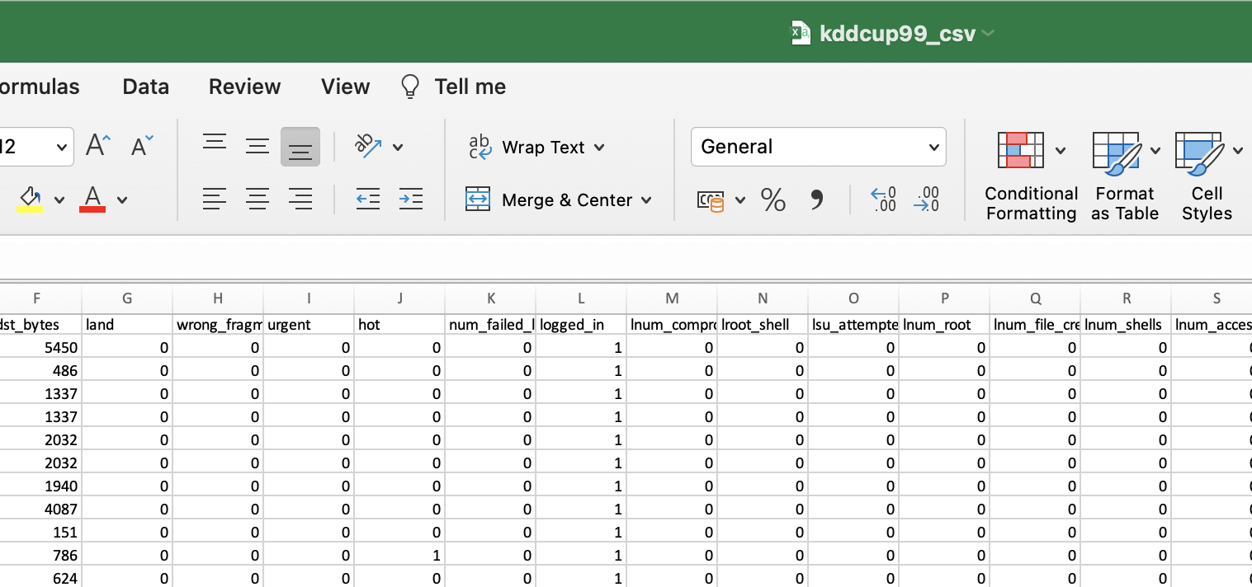
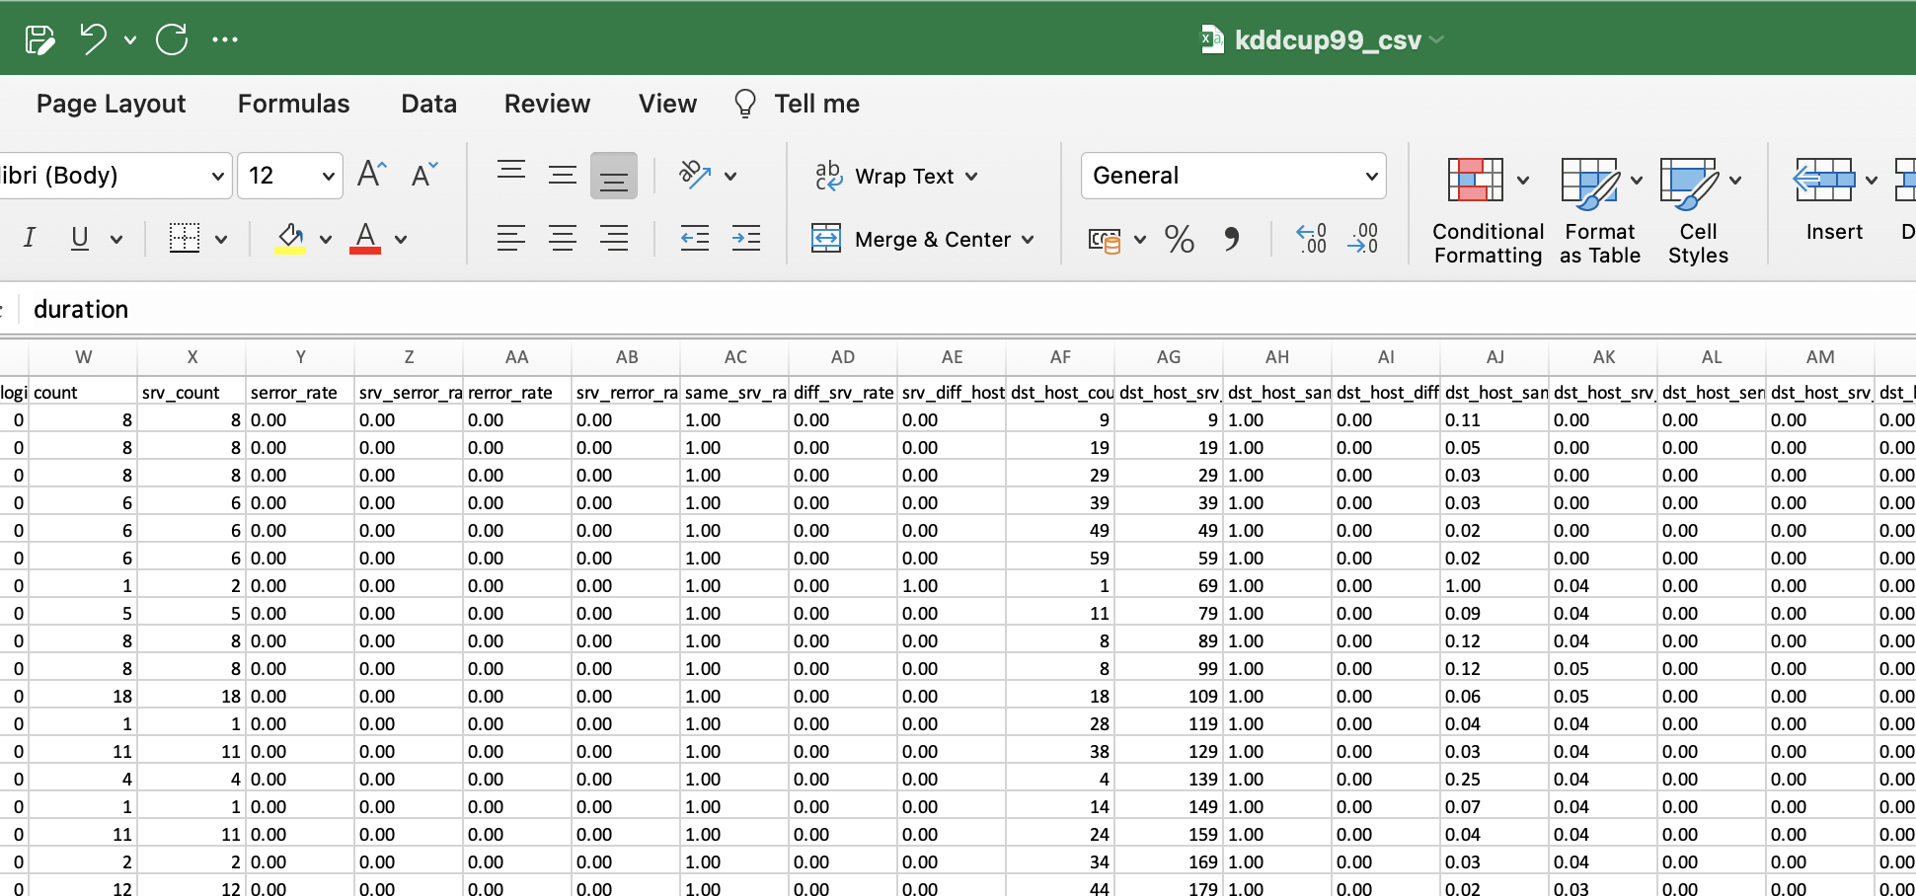
DARPA Intrusion Detection Dataset: It is one of the earliest datasets in network traffic. It was collected and published by Cyber System and Technology Group, formerly DARPA. This data consists of several weeks-long training and testing data with ground truth labels about intrusion detection assessment.
KDD CUP 99 Dataset: This is the most widely used and publicly available. It is created by replicating the original DARPA 1998 dataset and contains 4 900 000 replicated attacks. Each sample contains 41 input features divided into two, respectively: basic features and higher-level features. The basic features are directly extracted or derived from the header information of IP packets and TCP/UDP segments in the tcpdump files of each session. High-level features contain several failed logins and root access attempts during the session.

Slide 6
pipeline
For ML pipeline, we should create samples with features (X matrice) and corresponding labels (Y matrice). In our IDS scenario;
Features are extracted form TCP&IP header fields and failed logins, priviliged access stats, etc. There are 41 possible features, and for computational simplicitiy, 34 of them will be used. And, we have 23 classes, 0 = Teardrop, 1 = Satan, 2=port_sweep .... 22 = ftp_write, etc.
We should pre-process the data: convert labels or non-numeric features (such as protocol_type=“TCP” or service=“http”, etc.). Also, data needs to be scaled/normalized.
F₁ F₂ F₃ …. ….F₄₁ C [0,1]
S1
S2
S3
0
X
Y

Slide 7
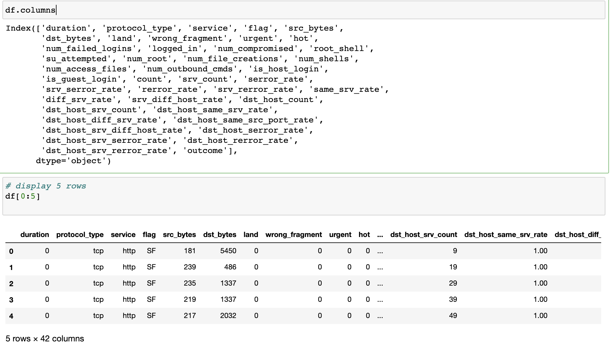
Features
Each sample in KDD Dataset contains 41 input features divided into two, Basic features and higher-level features, respectively: The basic features are directly extracted or derived from the header information of IP packets and TCP/UDP segments in the tcpdump files of each session. High-level features contain several failed logins and root access attempts during the session.

Slide 8
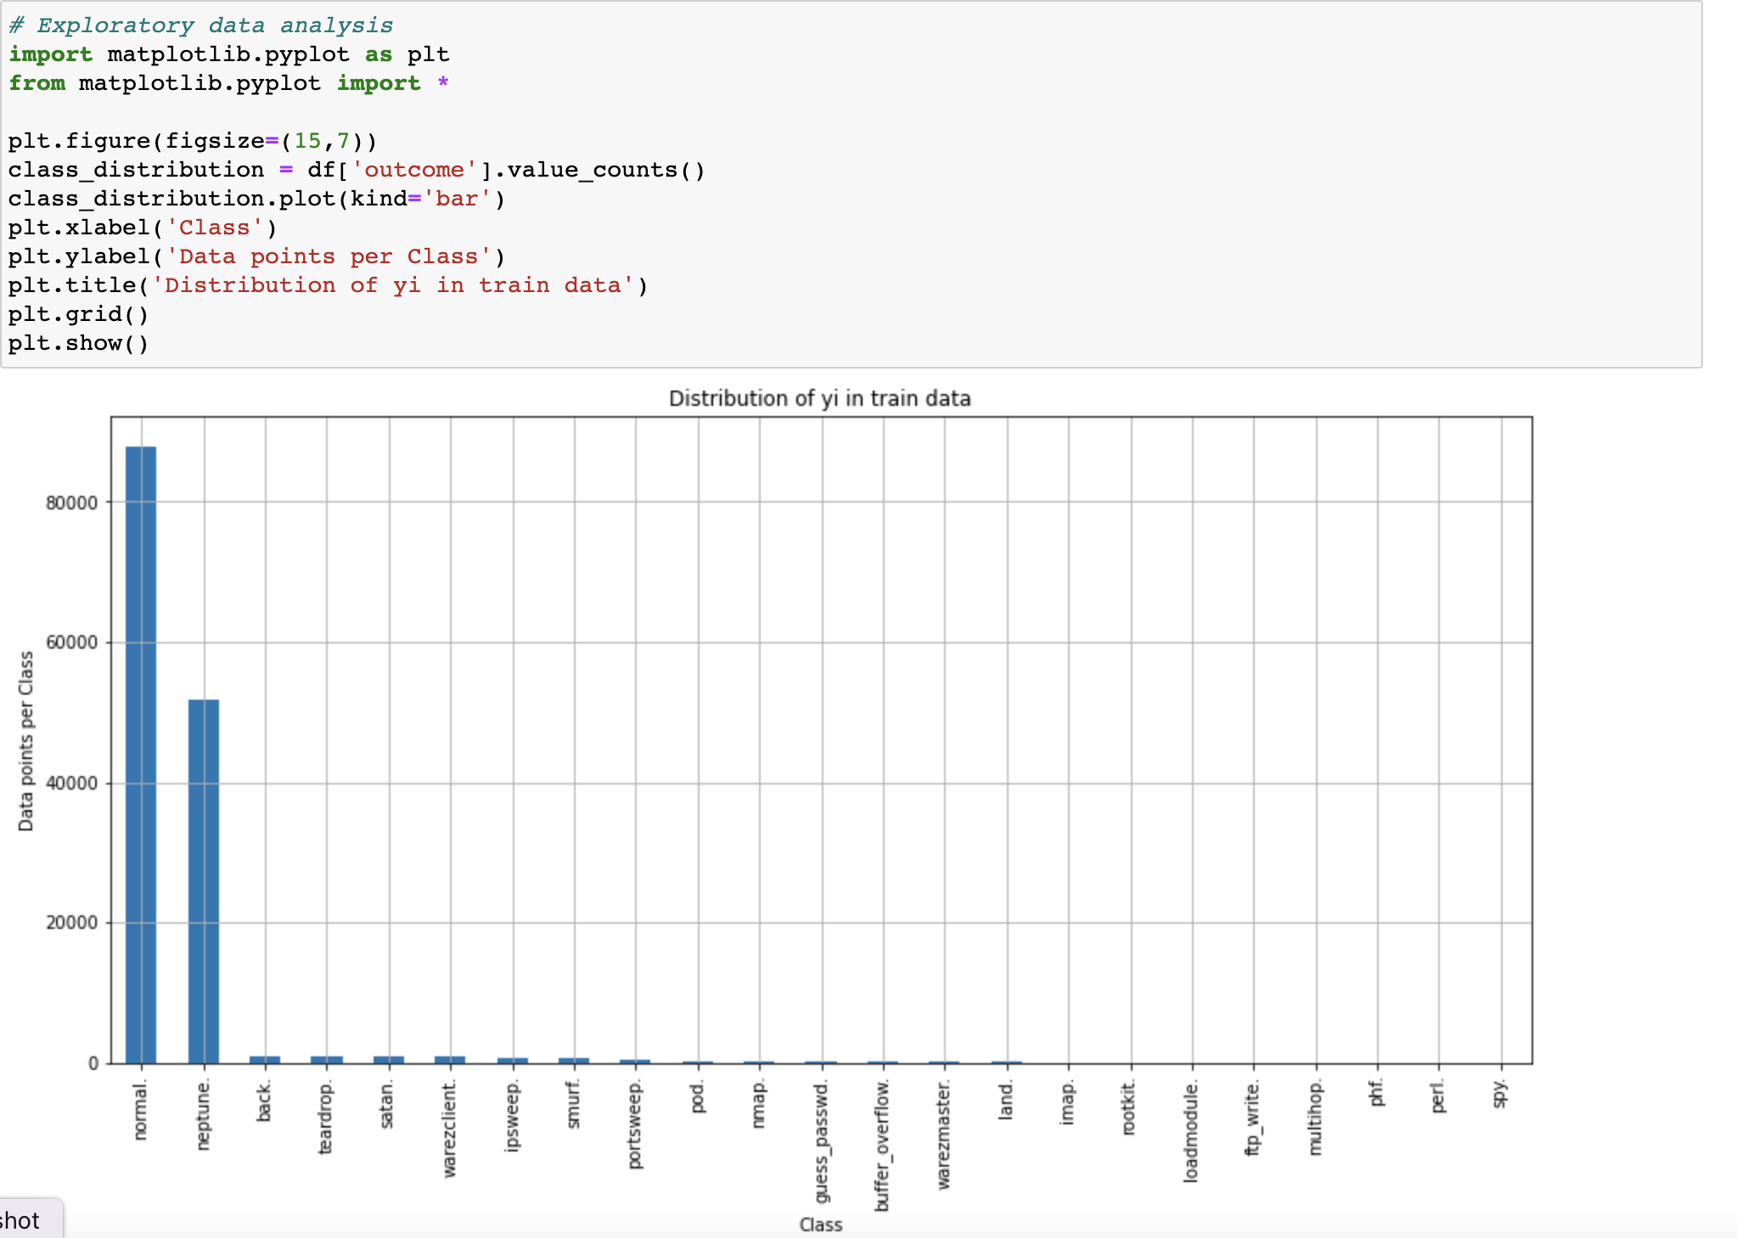
labels
There are 23 classes (teardrop, warezclient, satan, imap,smurf, portsweep, loadmodule, ftp_write, etc. ) in the KDD dataset. But all the classes except normal will be converted to abnormal since these cases represent attacks or other cyber incident states.
As a result, we solve this example as a two-class (binary) problem.

Slide 9
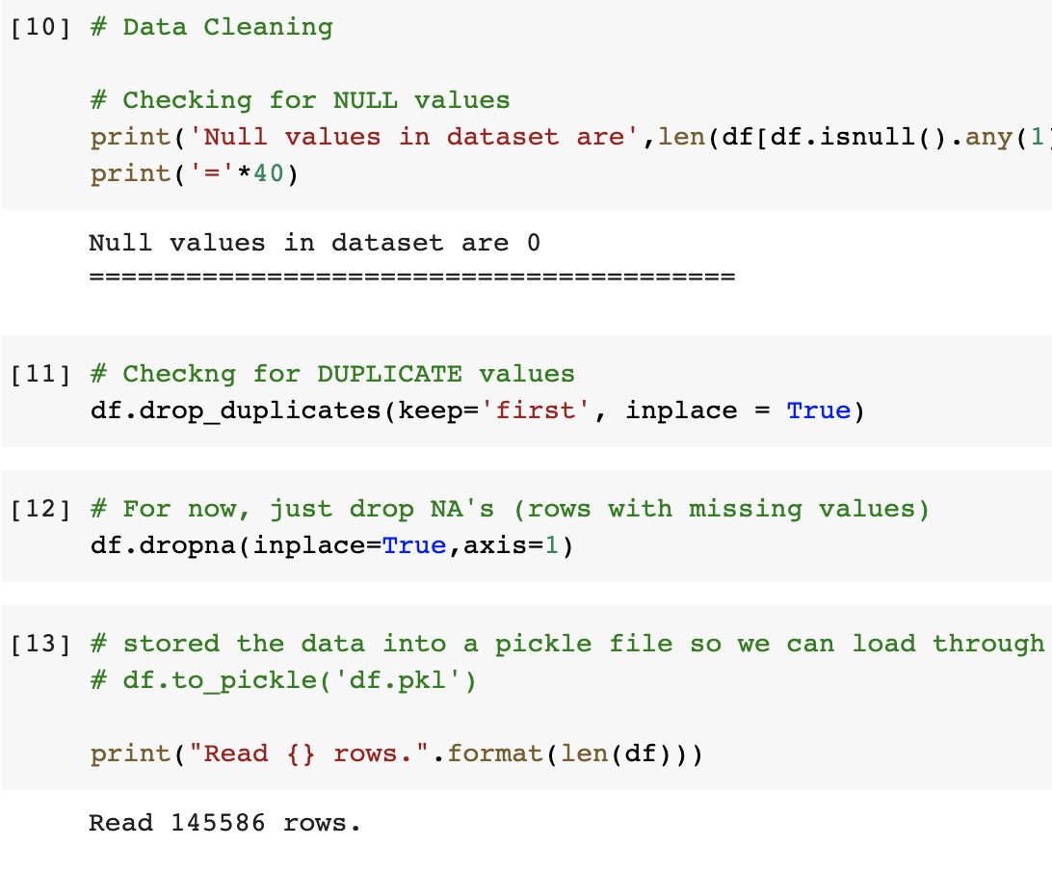
Pre-processing: data cleaning
The KDD data have duplicate samples. In the pre-processing part, duplicate records were cleaned, and 145.586 unique samples extracted.

Slide 10
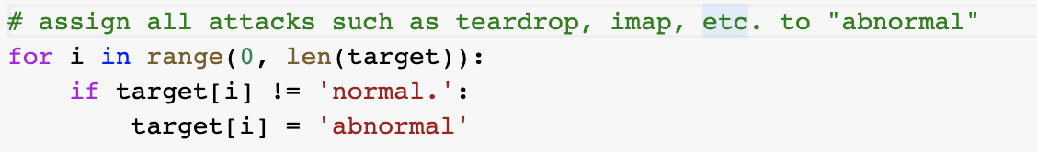
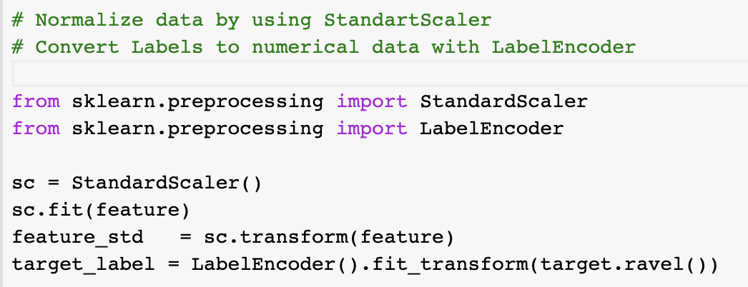
Pre-processing: Scaling, encoding to numerical type
Drop some features and save 34 features (NOTE: If dimensionality reduction is needed, PCA should be implemented).
Assign the targets that are belong to attacks as “abnormal”. So, we have a two-class problem now!
LabelEncoder can transform non-numerical labels to numerical labels. For example, the 2 labels in the dataset (“normal.” and “abnormal”) will be transformed to 0 and 1. StandardScaler can standardize the features by removing the mean and scaling to unit variance

Slide 11
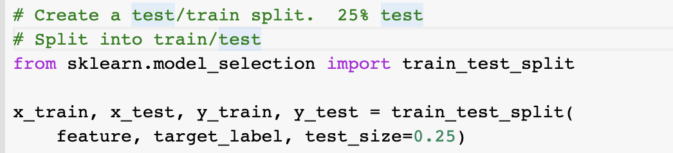
Pre-processing: splitting to training and testing datasets
Available data is divided into a training set (75% in our example), and a testing data set (25% in our example).

Slide 12
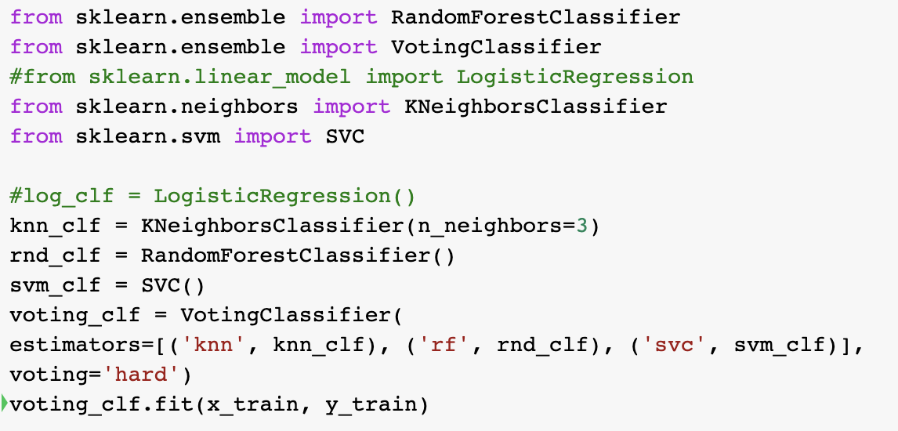
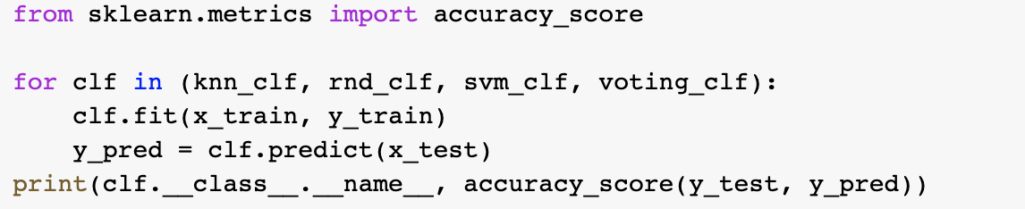
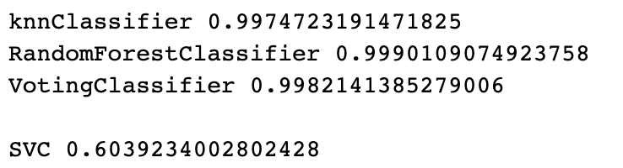
Classification
Traditional ML algorithms are used.
Moreover, an ensemble classifier is implemented by using KNN, Random Forest (Decision Tree), and SVM Classifiers.
Test some Traditional ML algorithms on a test data (never seen before, we have not used them in the training!). Measure the prediction accuracy
Traditional ML algorithms (except SVM) performed well on the test data.

